Slide 1
Nekudat Hen Conference 2015
Making decisions about environmental issues
William Sutherland, Miriam Rothschild Chair in Conservation Biology, University of Cambridge

Slide 2
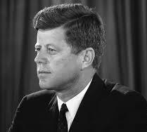

Will invading Cuba be successful?
25%
"timely execution of this plan has a fair chance of success"
>50%
Go ahead!
Notes:
Joint chief of staff

Slide 3
Select Committee on Intelligence on the U.S. Intelligence Community's Prewar Intelligence Assessments on Iraq
 | Department of defence | CIA
Iraq's attempts to purchase 60,000 high-strength aluminum tubes | Unlikely to be useful | Compelling evidence
Iraq arranged to purchase and import uranium from Niger | Compelling | Unlikely to have occurred

Slide 4
Spring 2011: Is Osama bin Laden living in Abbottabad?
Responsible CIA team leader 95%
Deputy Director of Intelligence 60%
Most people about 80%
Some, including tasked sceptics 30-40%
Obama: Discussion offered ‘not more certainty but more confusion’
Advisors were offering ‘probabilities that disguised uncertainty as opposed to actually providing you with more useful information’
President concluded 50:50
Average of 69%.

Slide 5

Frequency
0%
50%
100%
"This is fifty-fifty," "Look guys, this is a flip of the coin. I can't base this decision on the notion that we have any greater certainty than that."

Slide 6
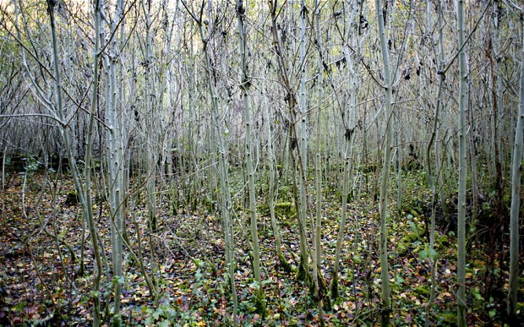
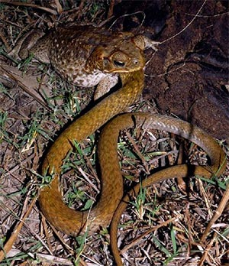
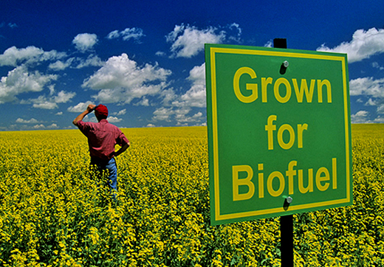
Some decisions

Slide 7
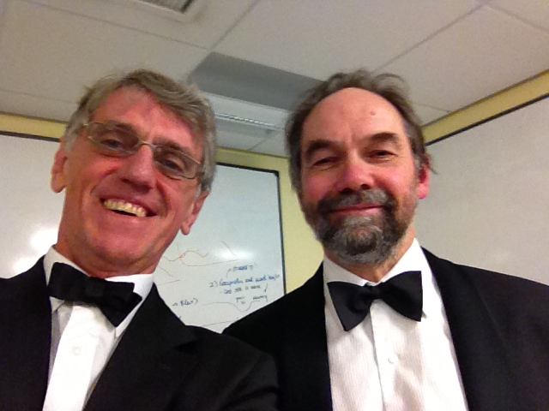
Evidence on experts

Slide 8
Consulting expert
Experts only slightly better than chance

Slide 9
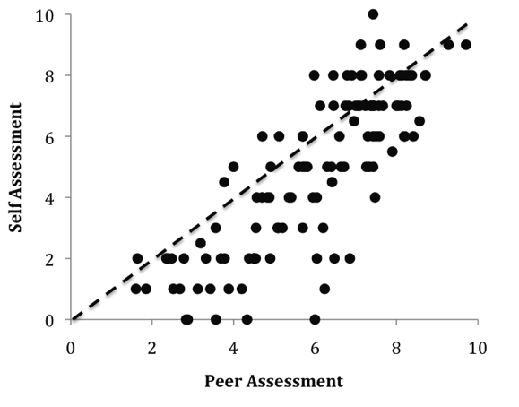

Identifying who is an expert

Slide 10
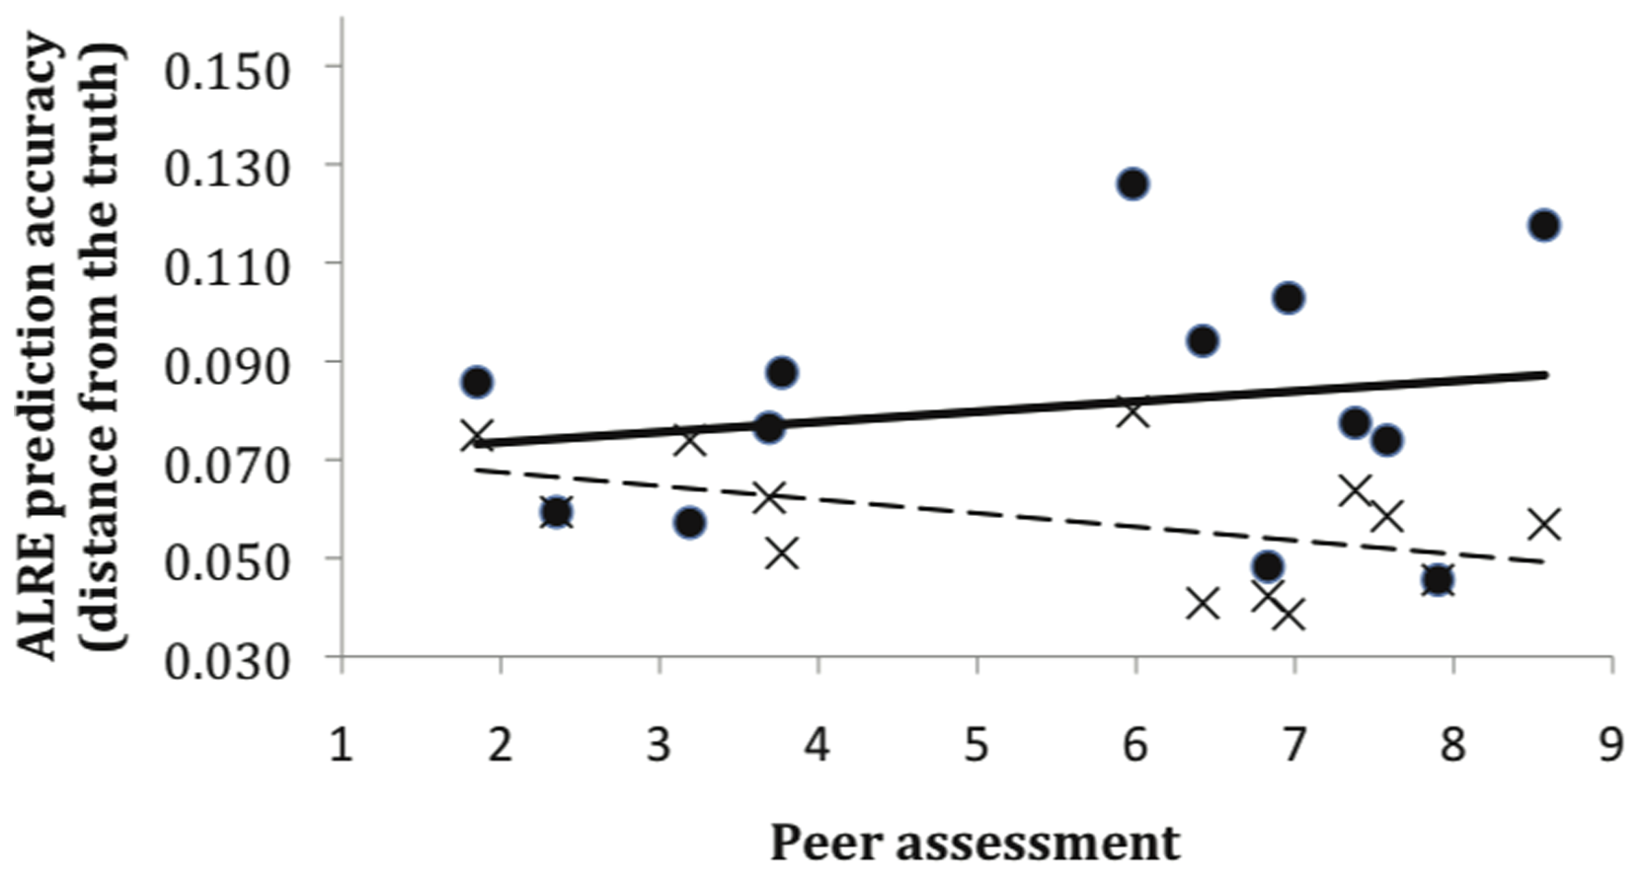
Identifying who really is an expert

Slide 11
Research conclusions:
The evidence is overwhelming group estimates consistently outperform individual estimates
Expertise declines dramatically outside the narrow domain of an individual’s technical specialization or experience
Age, number of publications, technical qualifications, years of experience, memberships of learned societies, and apparent impartiality do not explain an expert’s ability to estimate unknown quantities or predict future events
Diverse groups tend to generate more accurate judgements
People who are less self-assured and assertive, and integrate information from diverse sources make better judgments
Estimates of risks in many domains can be improved by weighting experts’ opinions by their performance on test questions
Relevant training can improve experts’ abilities to estimate probabilities of events
Chess players, weather forecasters, sports players, gamblers, intensive care physicians and physicists solving textbook problems make accurate judgements, which is considered to be due to rapid feedback.

Slide 12
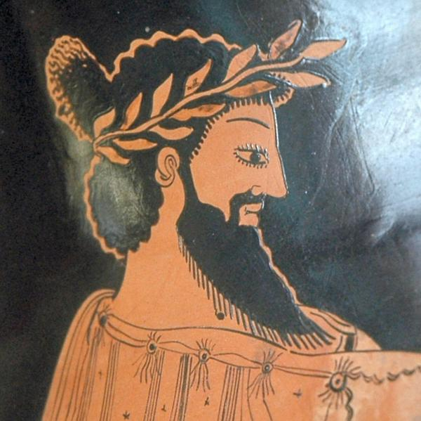
Croesus, king of Lydia 560 B.C., tested the oracles of the world for accuracy
Simultaneously sent emissaries to 7 oracles to ask what the king was doing
Oracle at Delphi reported king making lamb-and-tortoise stew in copper kettle.
Correct so he graced her with a magnitude of precious gifts.

Slide 13
Croesus then consulted Delphi before attacking Persia
Was advised, "If you cross the river, a great empire will be destroyed"
Croesus crossed river and attacked
Lost battle and his own empire that was destroyed.

Slide 14
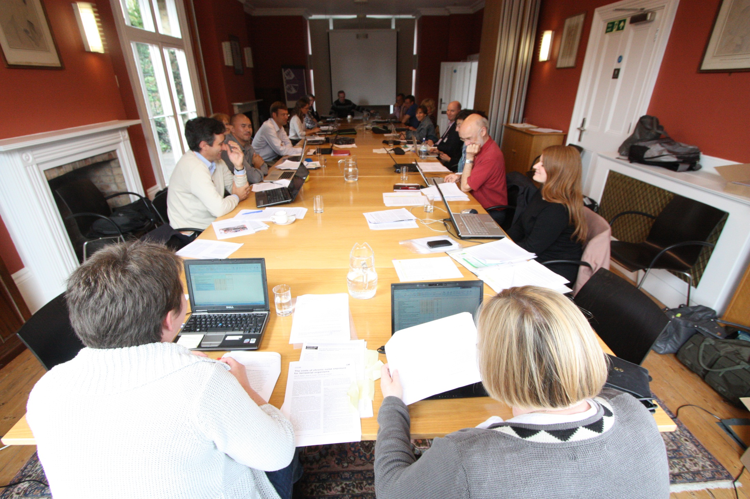

Slide 16
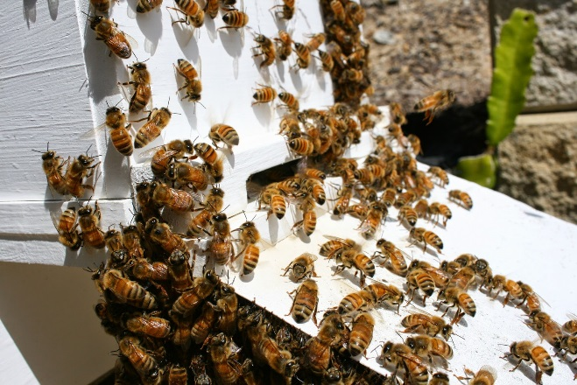
Managed bees as vectors
Bees as transporters (vectors) to deliver microbiological control agents (i.e., bacteria, viruses, or fungi) directly to the flowers of agricultural plants
Bees pick up the control agents by walking through a patch of powder as they leave their colony
Either honeybees or commercially managed bumblebees
Can control a range of fungal diseases or insect pests on many flowering crops in field or glasshouse conditions
The effects of delivering microbiological control agents directly to flowers on non-target wild insects and plants have not been evaluated.

Slide 17
Other issues on longlist
Ecological civilisation policies in China
Virtual currency transaction technology to verify land ownership
Organic farming drives clearance of natural ecosystems
Vertical urban farming
Perennial Grains
Insects converting waste to livestock feed
Rise of Fungicide Treatments
Glyphosate herbicide side effects
New techniques for measuring soil phosphorous
Use of laser lights in agriculture.

Slide 18
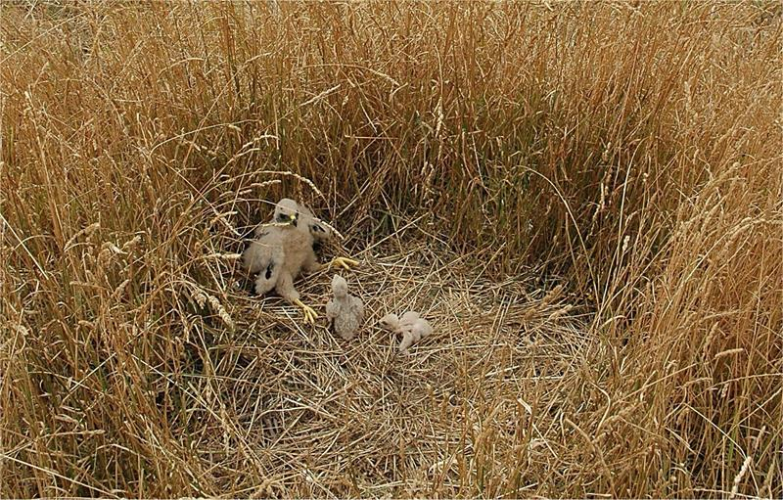
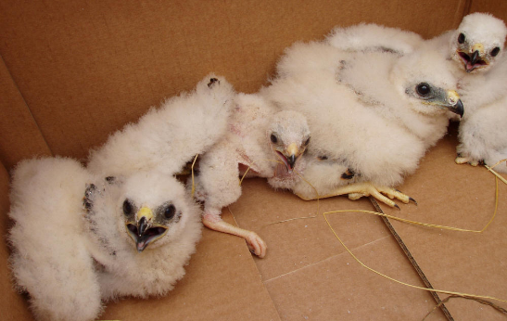
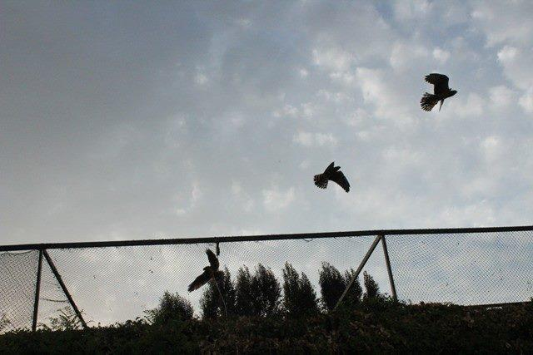
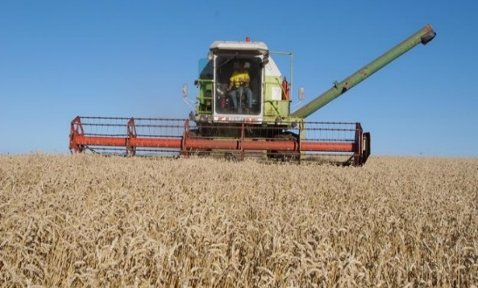
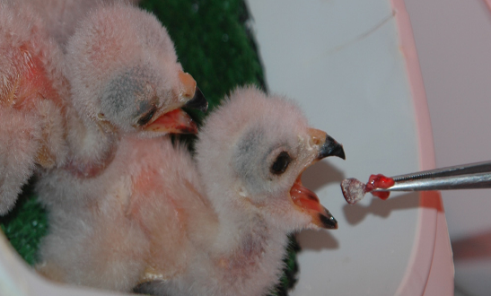
Harrier management in cropland
Spain 2015 - Release of >50 chicks hacked

Slide 19
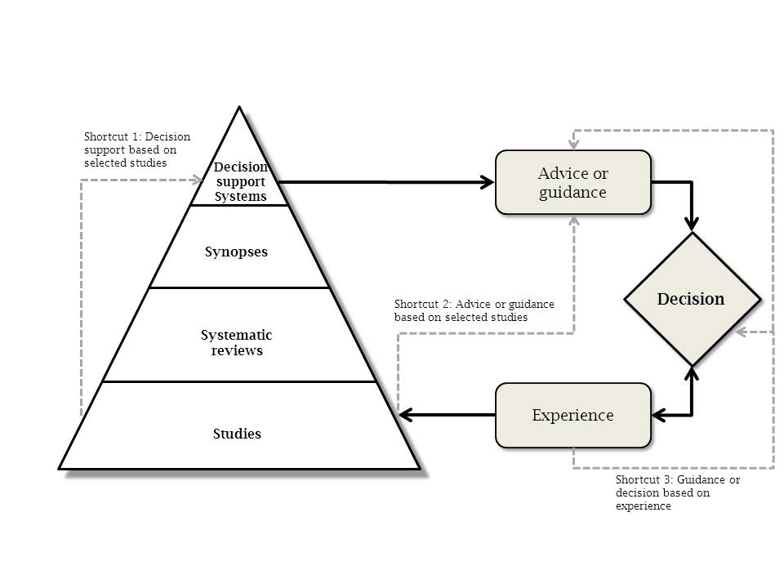
Dicks et al 2014 Organising evidence for environmental decisions: a '4S' hierarchy. Trends in Ecology and Evolution. Open access

Slide 20
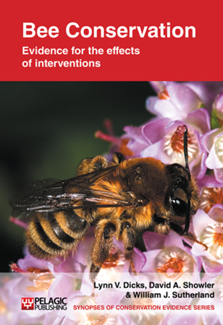
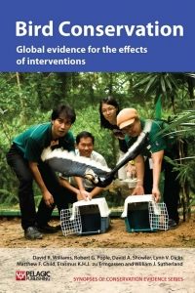
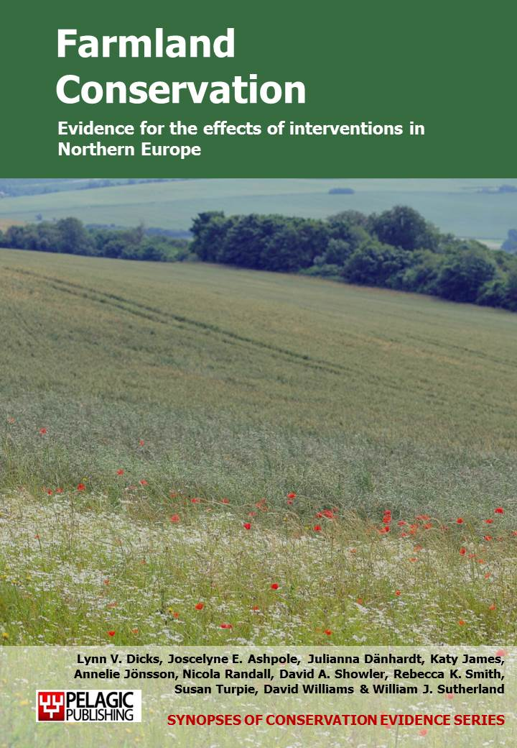
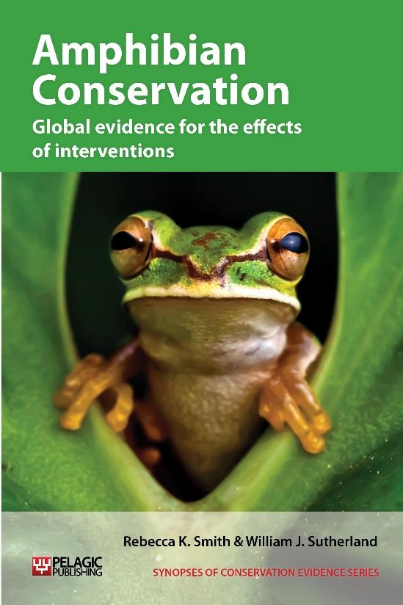
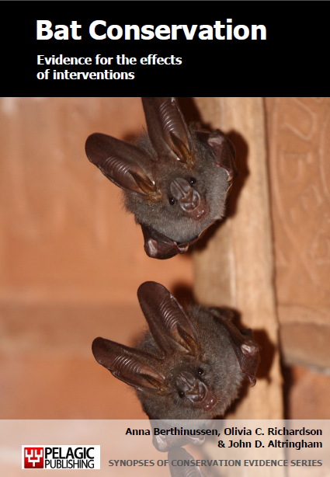
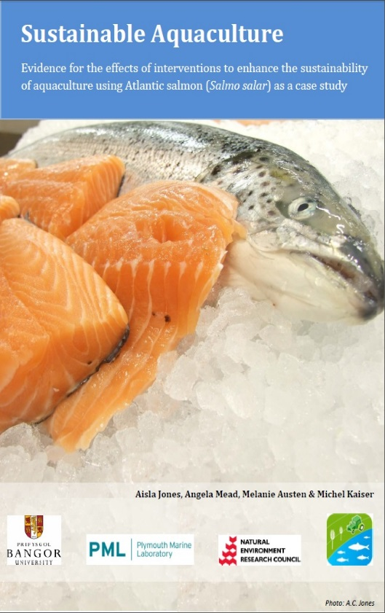
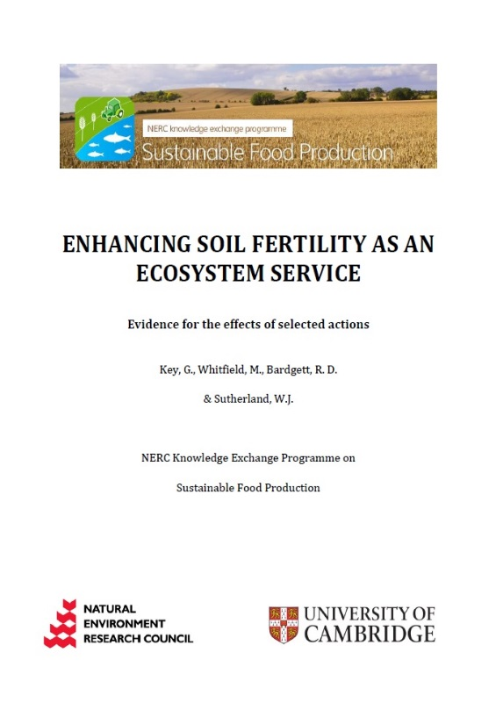
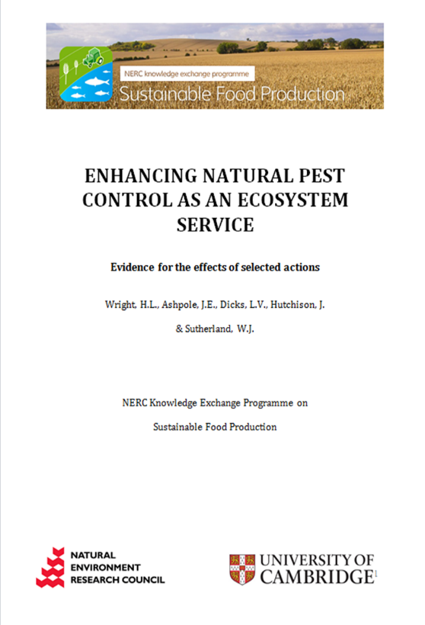
Available from all good bookshops
Or free as pdf from Conservationevidence.com
Or search for the interventions on ConservationEvidence.com

Slide 21
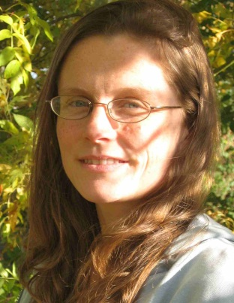
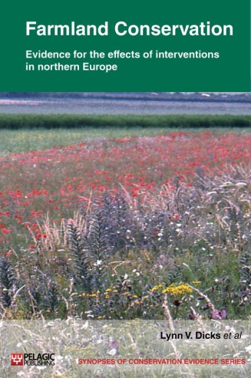
Evidence for CAP reform
Compulsory greening payment element | Relevant intervention for which compiled evidence was assessed by experts | Number of studies | Certainty of knowledge (%) | Proportion of experts who said ‘yes this benefits wildlife’
Retain permanent grassland | Revert arable land to permanent grassland | 9 | 20 | 0
Crop diversification | Increase crop diversity | 5 | 9 | 0
Ecological Focus Areas | Increase the proportion of semi-natural habitat in the farmed landscape | 5 | 22 | 0.2
- Hedges | Manage hedgerows to benefit wildlife | 20 | 50 | 0.7
- Buffer strips | Plant grass buffer strips/margins | 74 | 69 | 0.9
 | Create uncultivated margins around intensive arable or pasture fields | 52 | 67 | 1
 | Provide buffer strips alongside water courses | 7 | 17 | 0.1
- Land left fallow | Provide (or retain) set-aside areas in farmland | 58 | 68 | 0.9
Transparent, traceable, repeatable
Dicks et al 2013 Cons Lett

Slide 22
Classifying what works
100%
Ineffective
or harmful
Beneficial
Unlikely to
be beneficial
Likely to be beneficial
<20% harm
Unknown effectiveness
Certainty
0%
100%
Ineffective
or harmful
Trade-off between
benefits and harms
>20% harm
Unknown effectiveness
0%
0%
Effectiveness
100%

Slide 23
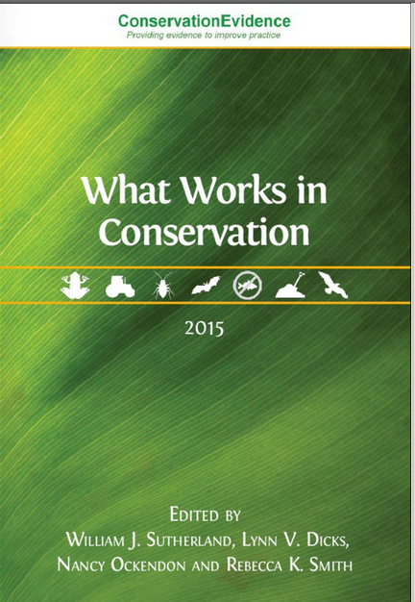

Slide 24
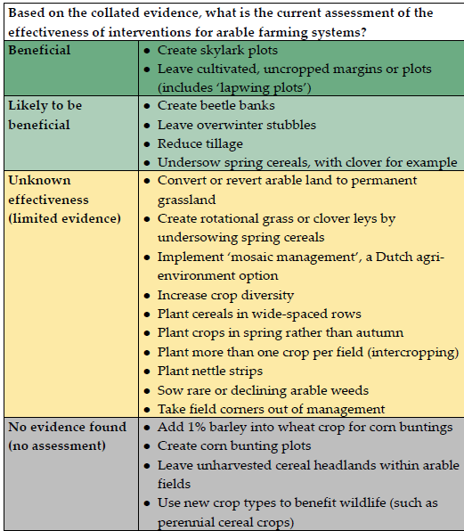

Slide 25
MANAGING FIELD MARGINS FOR BEES
ACTION Leave margin unsprayed (Conservation Headland)
No more bumblebees than conventional margins (2 studies)
ACTION Allow margin to naturally regenerate
More bumblebees than cropped margins, in some years (4 studies)
Value to bumblebees depends on thistle species (2 studies)
ACTION Sow with wildflower seed mix
Greater abundance and diversity of bumblebees than cropped (4 studies), grassy (2 studies) or naturally regenerated (1 study) margins
More long-tongued bumblebees than on annual forage plants (1 study)
ACTION Sow with agricultural bee forage plants (clovers, borage..)
More bumblebees than cropped or naturally regenerated margins (2 studies)
More bumblebees than on wildflower seed mix in some years (3 studies)
ACTION Sow with grasses
Greater abundance (2 studies) and diversity (1 study) of bees than cropped margins
More nest-searching queen bumblebees than conventional margins (1 study)
Notes:
Where the text says ‘more bees’ this means abundance, not (or not always) diversity as well. All but one of these studies just looked at bumblebees, not solitary bees.

Slide 26


Slide 27

Greening guidance
• Cutting but not grazing will be permitted on EFA buffer strips.
• Nitrogen Fixing Crops will count as EFA if:
- there is no harvesting before August 1, in order to protect ground-nesting birds;
- they are surrounded by an EFA field margin where adjacent to the edge of a field;
- there are two different Nitrogen Fixing Crops on the EFA area, to extend the flowering period for pollinators, with the main crop covering no more than 75 per cent of the total area of Nitrogen Fixing Crop declared as EFA.

Slide 29

Evidence buffer strips round fields shows…
Nineteen studies from Finland, the Netherlands, Sweden and the UK (including seven replicated controlled studies of which two were randomized, and three reviews), found that planting grass buffer strips (some margins floristically-enhanced) increased arthropod abundance, species richness and diversity. A review found grass margins benefited bumblebees and some other invertebrates but did not distinguish between the effects of several different margin types.
Nine studies from the UK (including seven replicated studies of which two were controlled, and two reviews) found that planting grass buffer strips (some margins floristically-enhanced) benefits birds, resulting in increased numbers, densities, species richness and foraging time.

Slide 30
Evidence buffer strips round fields shows…
Seven studies from the Netherlands and the UK (all replicated of which four were controlled and two randomized), found that planting grass buffer strips (some margins floristically-enhanced) increased the cover and species richness of plants. A review found grass margins benefited plants but did not distinguish between the effects of several different margin types.
Five studies from Finland and the UK (including two replicated, controlled trials and a review), found that planting grass buffer strips benefits small mammals: including increased activity and numbers.
Six studies from the Netherlands and the UK (including three replicated, controlled trials) found that planting grass buffer strips had no clear effect on insect numbers, bird numbers or invertebrate pest populations. A replicated site comparison found sown grassy margins were not the best option for conservation of rare arable plants.

Slide 31
And riparian buffer strips…
Three studies (including one replicated site comparison) from the Netherlands and the UK reported that the provision of riparian buffer strips had a positive influence on plant, invertebrate and bird diversity or abundance, and supported vegetation associated with habitats preferred by water voles.
Two replicated site comparison studies from France and Ireland found that the provision of riparian buffer strips on farms did not result in an increase in the number of plant species when compared to farms without buffer strips.
One replicated site comparison study found ground beetle diversity was higher in grazed riparian zones and narrow fenced strips than in wide riparian buffer strips. However the ground beetle assemblages in wide riparian buffer strips were more distinct from the adjacent pasture field assemblages than either the grazed riparian zones or narrow fenced strips.

Slide 32

And evidence for legumes in a crop rotation for soils...
Biodiversity: Four randomized, replicated trials from Canada, Portugal and Zambia measured the effect of including legumes in crop rotations and found the number of microbes and diversity of different soil animals increased.
Erosion: One randomized, replicated trial from Canada found that including forage crops in crop rotations reduced rainwater runoff and soil loss, and one replicated trial from Syria showed that including legumes in rotation increased water infiltration (movement of water into the soil).
Soil organic carbon: Four studies from Australia, Canada, and Denmark (including two controlled replicated trials and one replicated site comparison study), found increased soil organic carbon under crop rotation, particularly when some legumes were included.
Soil organic matter: Three of five replicated trials from Canada, Portugal and Syria (one also randomized, one also controlled and randomized), and one trial from the Philippines found increased soil organic matter, particularly when legumes were included in the rotation. One study found lower soil organic matter levels when longer crop rotations were used. One randomized, replicated study found no effect on soil particle size

Slide 33
And impact legumes on bees…
One study suggests a benefit to bumblebees from planting more beans, another study shows the effect on bumblebee numbers can only be detected during flowering.
Good evidence that increased area of some of the alternative suggestions for Ecological Focus Areas – semi-natural habitats – in farmed landscapes is associated with finding more bees (lots of evidence, agreement). These habitats also benefit other wildlife, including birds.

Slide 34
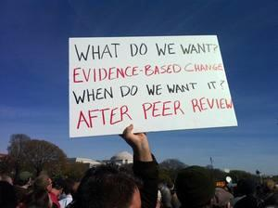
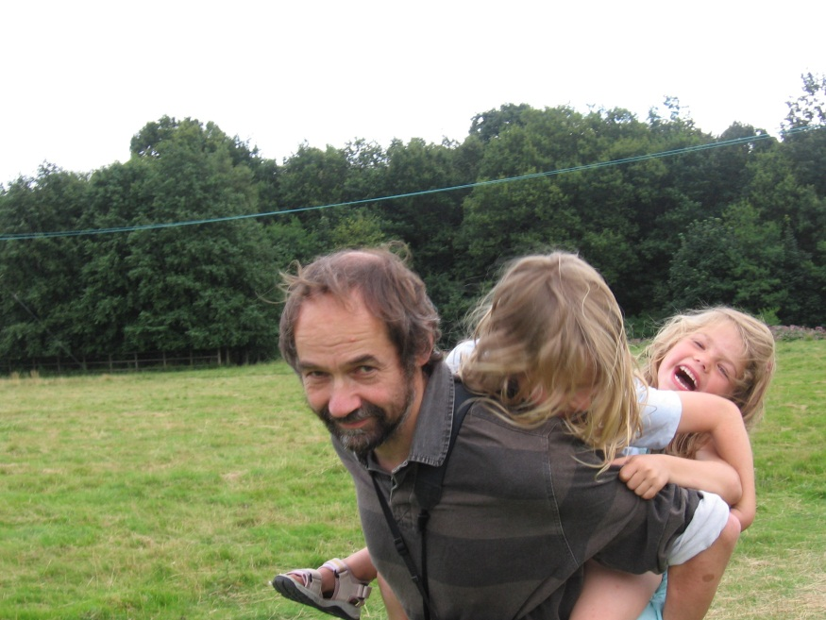
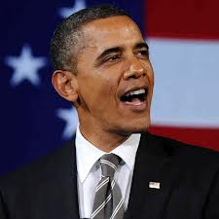
Reasons to be cheerful
Anna Sutherland (aged 10) school report for Science
‘Anna is progressing well,
but must take a more evidence-based approach.’

Slide 35

BES/CCI conference
Science and policy
11-13th April 2016 be there!

